Slide 1

Notes:
Because we would like to make a meaningful contribution to our world we launched our frim commitment for this effort.
Scouts for SDGs mobilization.

Slide 2


Contributing to the Sustainable Development Goals (SDGs) with the Better World Framework

Slide 3


Align the Youth Programme with the SDGs
2
ways to contribute to the SDGs
Implement the Better World Framework

Slide 4












Slide 5
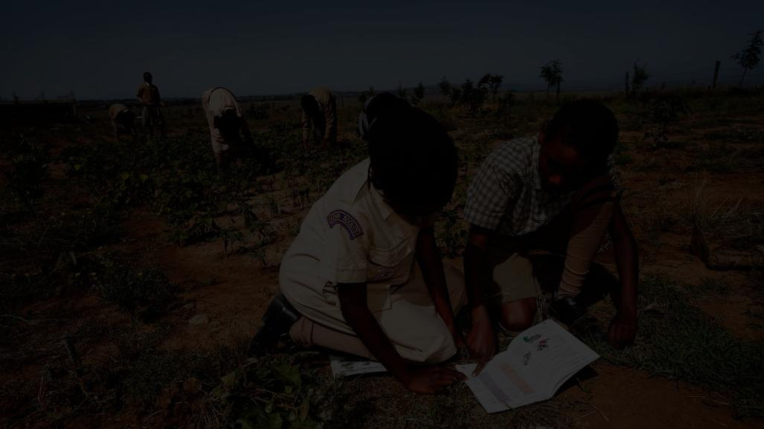
Is a set of coordinated programmes, campaigns, calls to action, and events designed to develop the competencies of young people to become global active citizens by taking action around issues related to sustainable development.
The
Better World
Framework

Slide 6
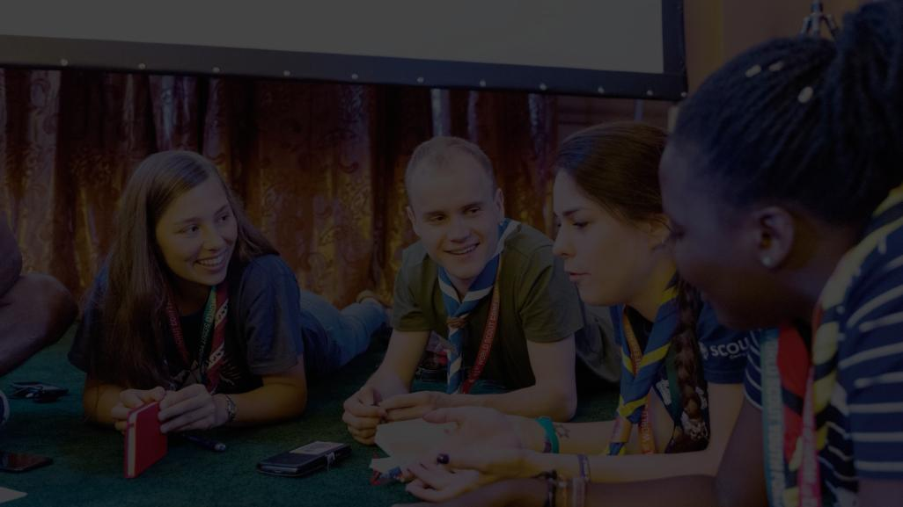
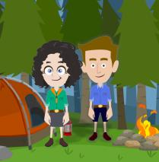


The purpose
Community development occurs through the actions of young people
Young People become active citizens through actions in the community
Notes:
Emphasise on this.

Slide 7
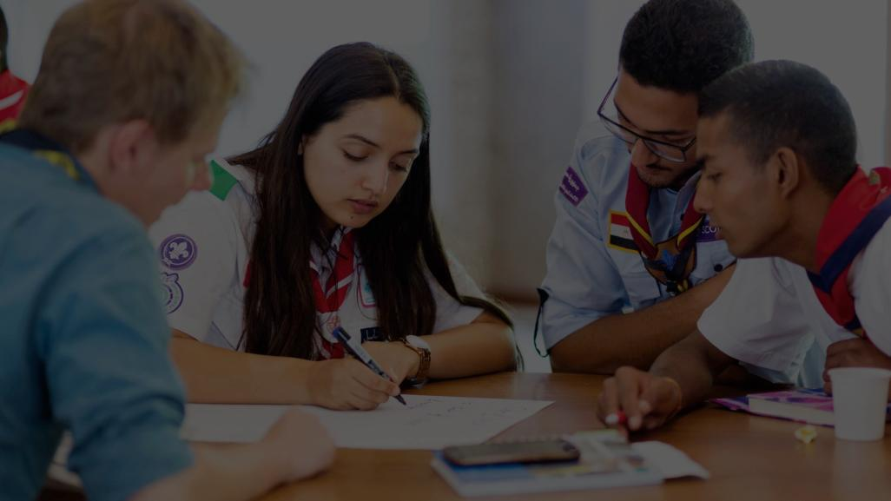
Benefits for Community Actors and Partners
ç
empowers young people to contribute to sustainable development
provides opportunities for partners to engage young people around key global issues
encourages collaborations with National Scout Organizations (NSOs) in the development of initiatives to tackle relevant local issues affecting young people and their community
allows experts to work with young people in the development of innovative solutions, in collaboration with young people.

Slide 8
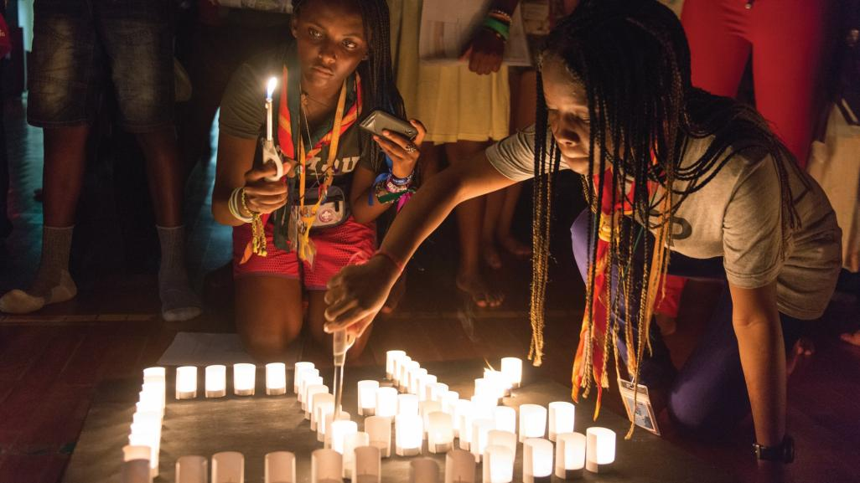
Benefits for NSOs
This approach benefits NSOs as it
aligns NSOs’ educational objectives that are related to active global citizenship and community development with common global goals
aligns NSOs’ community development initiatives with specific SDGs and competencies for sustainable development

Slide 9
provides a common monitoring and evaluation system to measure and report on the totality of Scouts’ contribution to the achievement of the SDGs
facilitates the incorporation of topics and the development of new resources by WOSM (national, regional, and world levels)
Benefits for NSOs

Slide 10
Benefits for NSOs
creates opportunities for partners that can help develop initiatives to tackle relevant local issues affecting young people and community

Slide 11
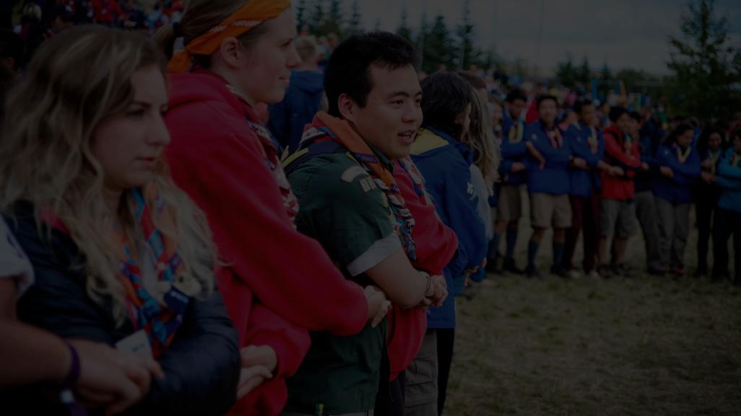
Young People in the Lead
Scouts of all ages
Cub Scouts (7-11 years of age),
Scouts (11-15 years of age),
Ventures and Rovers (15 and above)
are developing key competencies for sustainability and taking action for sustainable development.
Who are the
key actors in the Better World Framework

Slide 12
Who are the
key actors in the Better World Framework
WOSM and NSOs
Providing support and information, and developing capacity in adult leaders to empower young people to take action

Slide 13
Who are the
key actors in the Better World Framework
Community Actors
Providing insights, expertise, and networks to support young people

Slide 14
Who are the
key actors in the Better World Framework
Partners
Supporting young people and NSOs by providing knowledge and financial support, as well as developing capacity

Slide 15


Our Initiatives
Calls to action, campaigns, and programmes and events
Notes:
Ask for the names of the programmes or if they have participated in any of them.
Get three answers and ask what are other initiatives in their own country that are creating a better world.
( The interreligious dialogue badge is pending the final agreement of its design.)

Slide 16








Our Initiatives
Calls to action, campaigns, and programmes and events
Notes:
Ask for the names of the programmes or if they have participated in any of them.
Get three answers and ask what are other initiatives in their own country that are creating a better world.
( The interreligious dialogue badge is pending the final agreement of its design.)

Slide 17
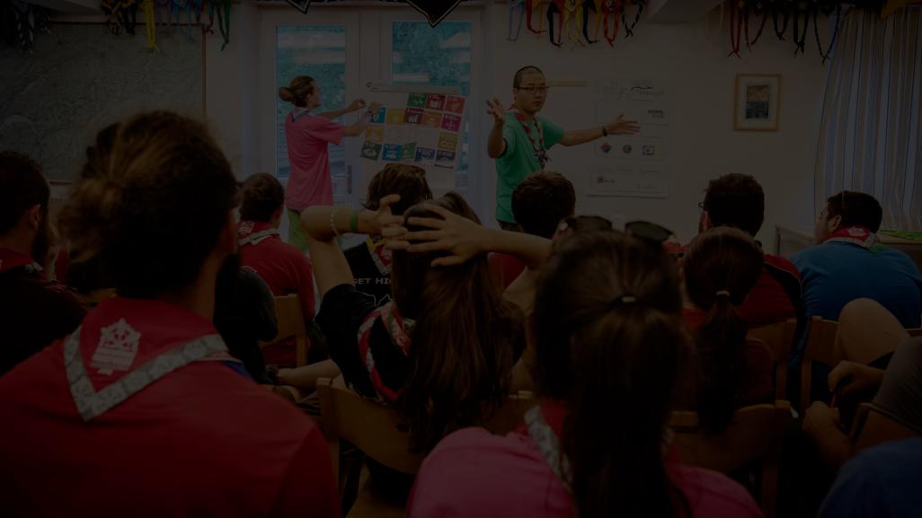

Each initiative is connected to the SDGs.
Notes:
.

Slide 18
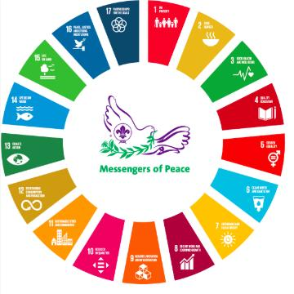


Slide 19
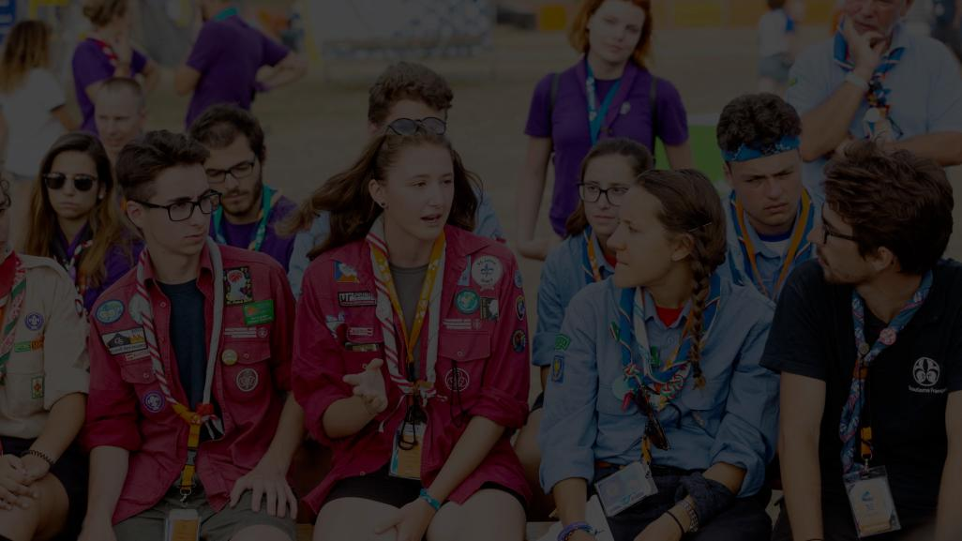
How are the learning opportunities related to the SDGs?
Notes:
Very fast sharing of the following programmes. We do not get into deep explanation of each but emphasise on their link with the SDGs.

Slide 20
























Linking the initiatives with the SDGs
✔️ | ✔️ | ✔️ | ✔️ | ✔️ | ✔️ | ✔️ | ✔️ | ✔️ | ✔️ | ✔️ | ✔️ | ✔️ | ✔️ | ✔️ | ✔️ | ✔️
 |  |  | ✔️ |  | ✔️ | ✔️ |  |  |  | ✔️ | ✔️ | ✔️ | ✔️ | ✔️
✔️ | ✔️ | ✔️ | ✔️ | ✔️ | ✔️ | ✔️ | ✔️ | ✔️ | ✔️ | ✔️ | ✔️ | ✔️ | ✔️ | ✔️ | ✔️ | ✔️
 |  |  | ✔️ |  |  |  |  |  |  |  |  |  |  |  | ✔️
 |  |  | ✔️ | ✔️ |  |  |  |  | ✔️ | ✔️ |  | ✔️ |  |  | ✔️
 |  |  | ✔️ |  |  | ✔️ |  |  |  | ✔️ | ✔️
 |  |  | ✔️ |  |  |  |  |  |  | ✔️ |  |  |  |  |  | ✔️
Notes:
These programmes have been linked to the SDGs. This can be an example of how you look at your current Youth Programme and align it with the SDGs that you tackle. It will then give you information on what you may be lacking and may want to develop more.
If you do this exercise, never forget that the SDGs are interconnected and indivisible. Work on one Goal will always influence the other Goals. Therefore, focus on the key areas and topics that you might not have, but also ensure that your programme covers the more holistic sustainability competencies that we saw earlier, and also present the SDGs as a whole rather than just small parts.

Slide 21
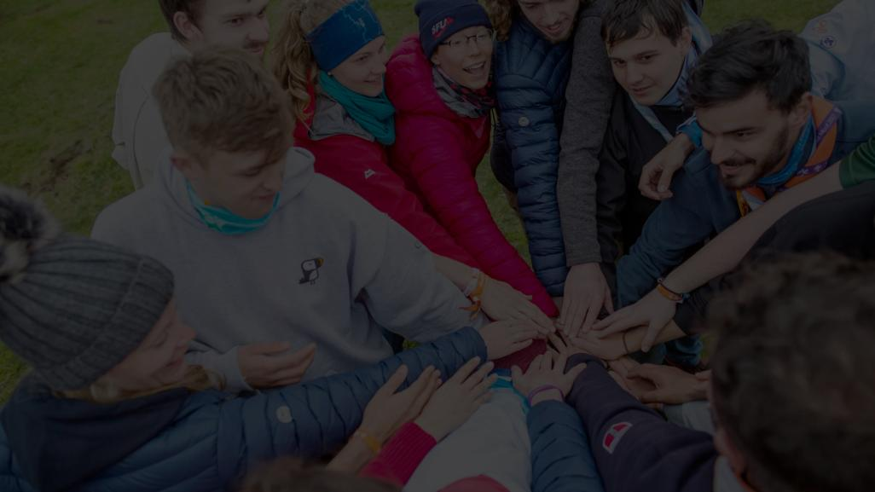
Let’s have a look at each of the initiatives.
Notes:
Very fast sharing of the following programmes. We do not get into a deep explanation of each but emphasise on their link with the SDGs.

Slide 22
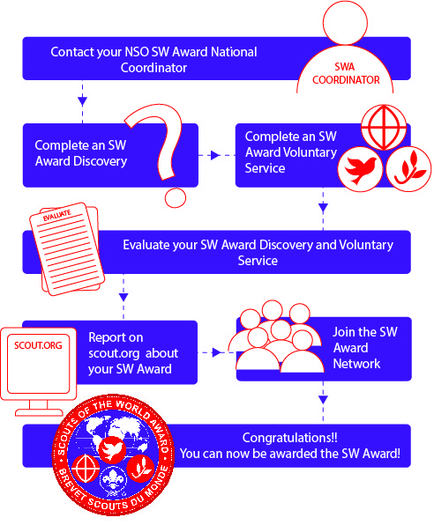

The Scouts of the World Award

Slide 23
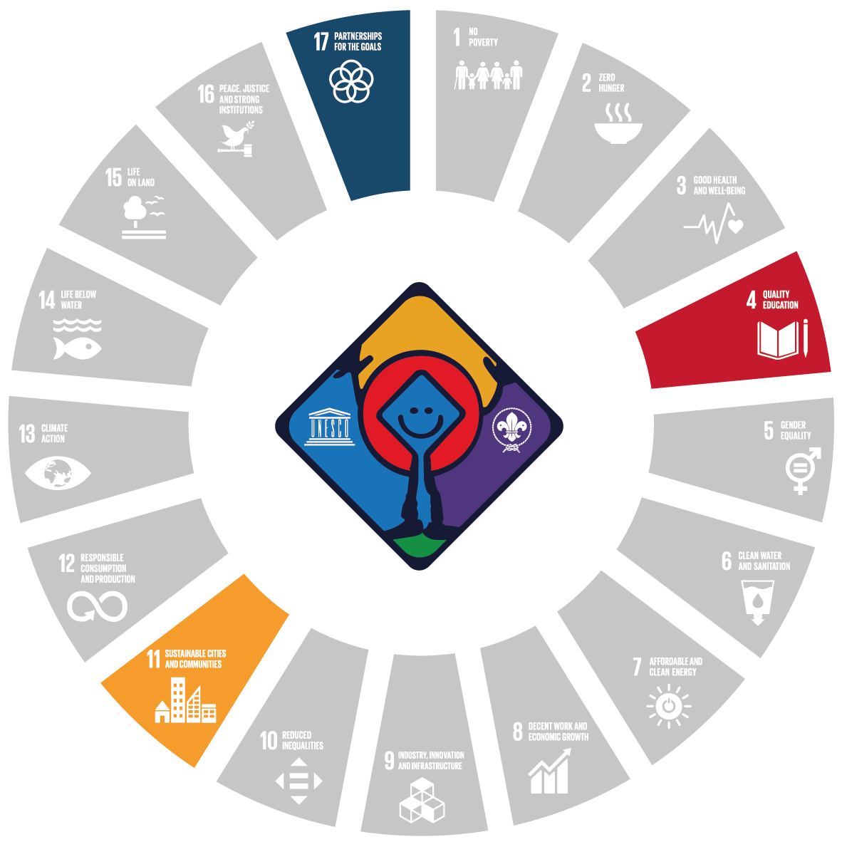
The Patrimonito Scout badge (World Scouting – UNESCO World Heritage Recognition programme)
Young people aged between 15 and 26 years old
Scouts and non-Scouts
Raise awareness and mobilise young people to participate and help in World Heritage preservation and promotion
Notes:
Challenges young people aged between 15 and 26 years old, Scouts and non-Scouts, to carry out their Scout of the World Award Discovery and voluntary service on a UNESCO World Heritage site.
This programme aims to raise awareness and mobilise young people to participate and help in World Heritage preservation and promotion.

Slide 24

World Scout Environment Programme
Connect with nature, to think about how to interact with the environment, and to take action to protect it.
5 aims
People and natural systems
Sufficient natural habitat
Risk of harmful substances
Environmental practices
People are prepared for hazards and natural disasters
Notes:
WSEP

Slide 25

The Scouts Go Solar badge
Create awareness, increase knowledge, and develop the skills of Scouts with regard to solar energy.
Notes:
WSEP

Slide 26

The HeforShe campaign
(UN Women Solidarity Movement for Gender Equality)
Action kit developed in collaboration with the UN’s HeForShe Movement
Gender equality
Quality of education
Social inclusion
Advocacy
Notes:
WSEP

Slide 27

The Dialogue for Peace Programme
(In partnership with KAICIID)
To gain mutual respect and mutual understanding, and to learn about each other’s identities while appreciating differences
Notes:
WSEP

Slide 28

The Messengers of Peace Programme and Network
To contribute to the construction of a Culture of Peace in collaboration with community members and an international network of Scouts
3 ways to create peace
Personal, Community based, Collective result
4 steps
Inspire, Learn & Decide, Do, and Share
Notes:
WSEP

Slide 29
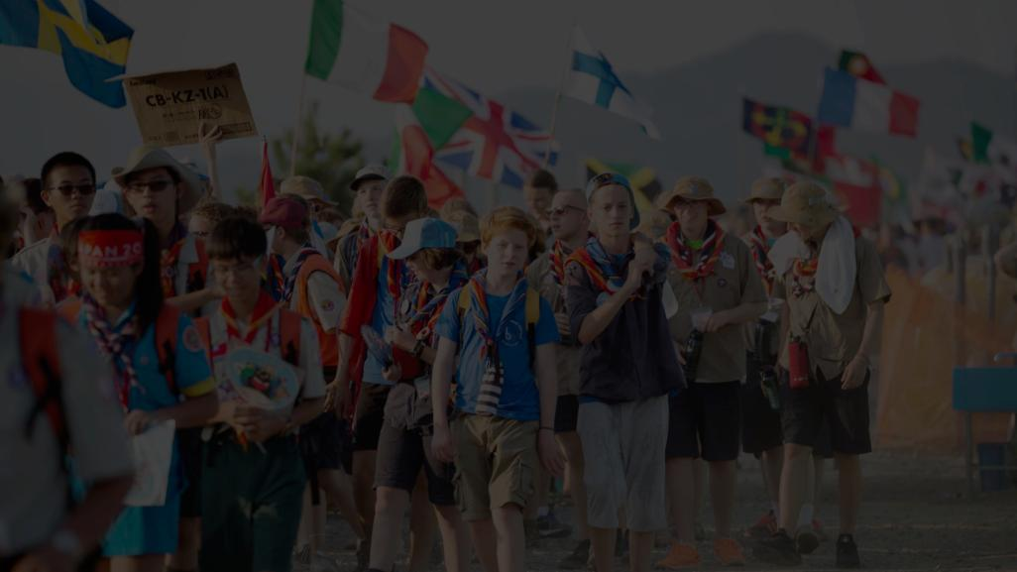
When young people take part in any of the programmes:
They contribute to specific SDGs.
They develop COMPETENCIES for sustainable development.

Slide 30
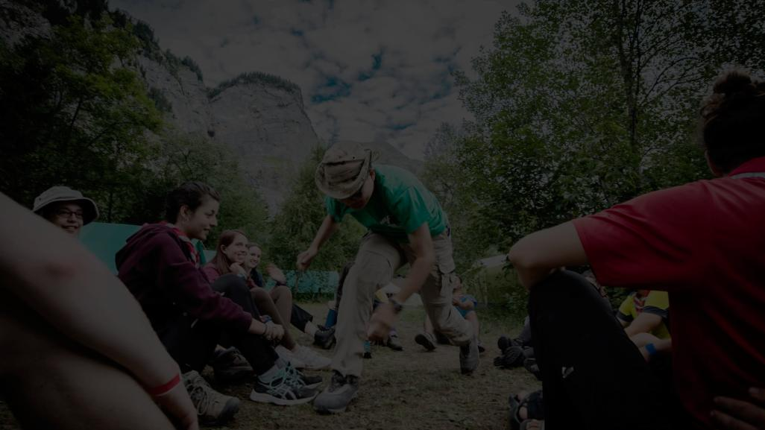
New initiatives can be incorporated in the Better World Framework to
acknowledge best practices of NSOs that can be replicated globally
encourage youth engagement to address local issues
join efforts with partners to support youth empowerment and sustainable development

Slide 31
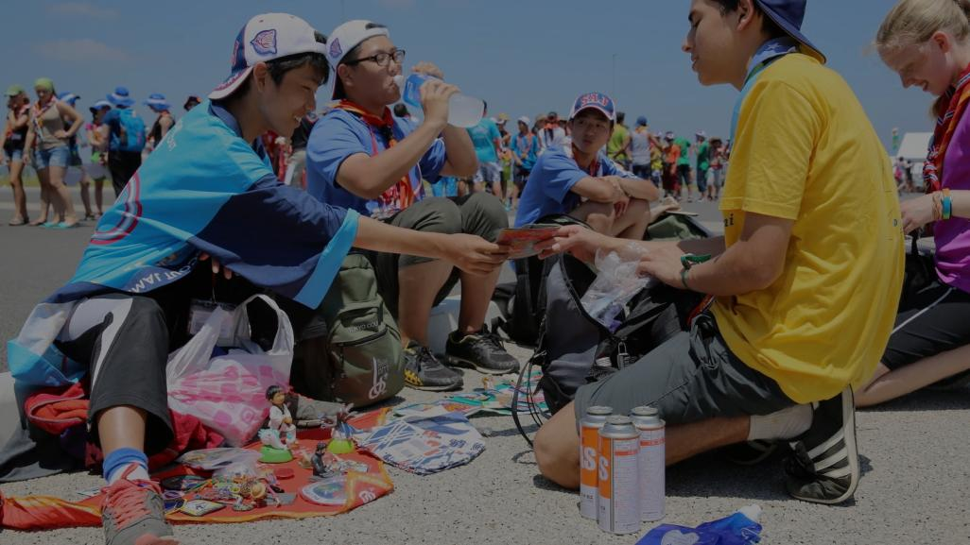
The Scout Donation Platform empowers young people to tackle local issues.
donate.scout.org
Notes:
Sustainable development is commonly defined as “development that meets the needs of the present without compromising the ability of future generations to meet their own needs.” This was proposed in the Brundtland report.

Slide 32
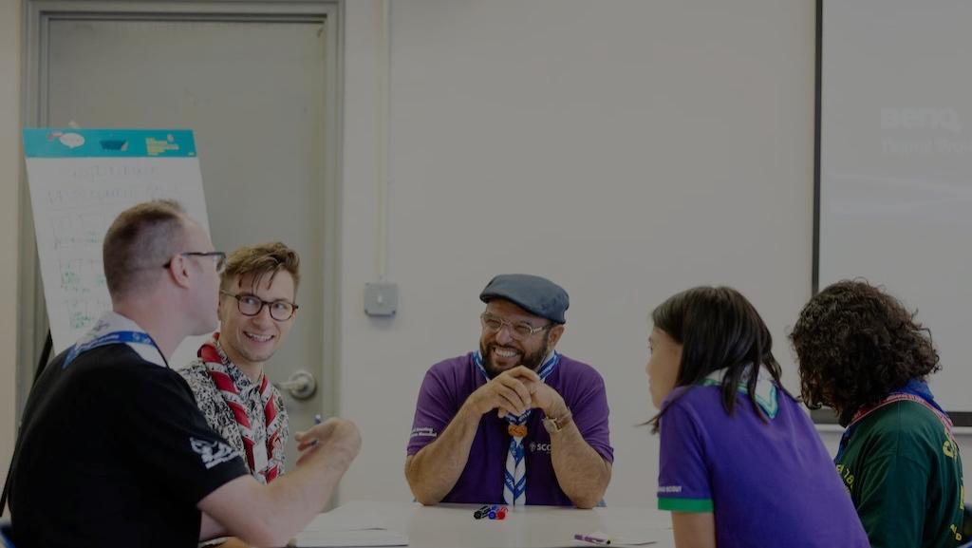
All actions, projects, calls to action, and campaigns carried out to develop the local community contribute to the SDGs.
Notes:
Sustainable development is commonly defined as “development that meets the needs of the present without compromising the ability of future generations to meet their own needs.” This was proposed in the Brundtland report.

Slide 33








Our network of partnerships around the SDGs

Slide 34

Check out how
Youth Programme alignment
can contribute to the SDGs.
Notes:
Sustainable development is commonly defined as “development that meets the needs of the present without compromising the ability of future generations to meet their own needs.” This was proposed in the Brundtland report.

Slide 35
#SCOUTS4SDGS
THANK YOU!

